Slide 1
SHAMU Mobile Monitoring Application (SHAMU-MMA)
The native Android application for monitoring CHDR on your mobile device!

Slide 2
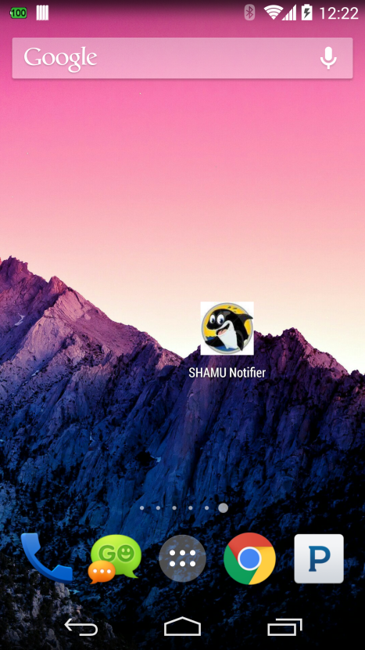
SHAMU Home
Welcome to the future of alerting at the VA! The following image will be displayed when you install the SHAMU Mobile Monitoring Application (SHAMU-MMA)

Slide 3
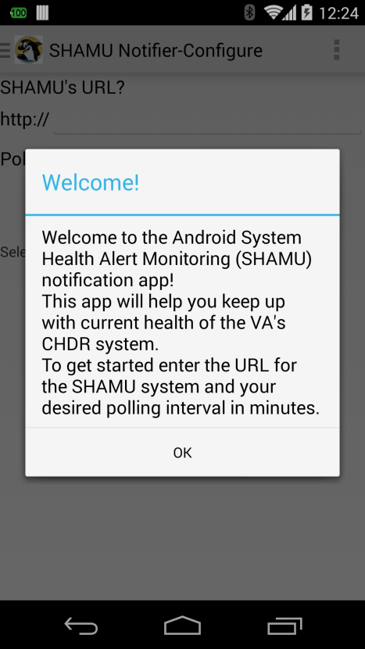
SHAMU Welcome
Welcome screen – When you first start the application you will be presented with a welcome screen. Clicking ‘OK’ will present you with the configuration screen.

Slide 4
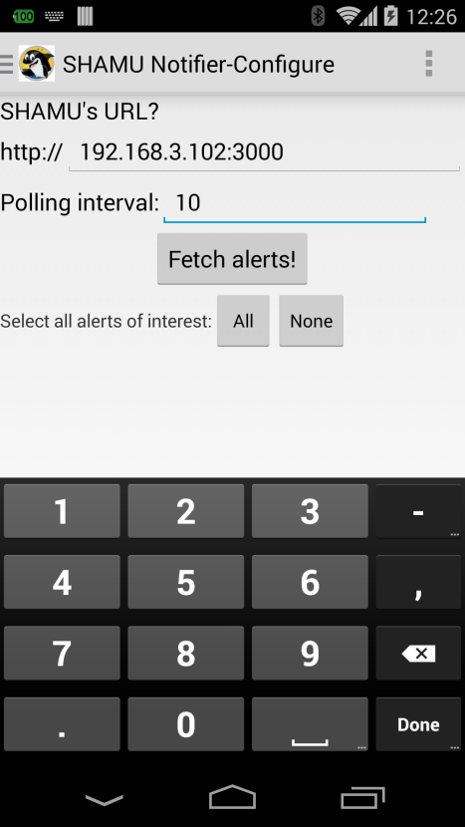
SHAMU Welcome
Configure – Set your endpoint to SHAMU and your polling interval and click ‘Fetch Alerts’.

Slide 5
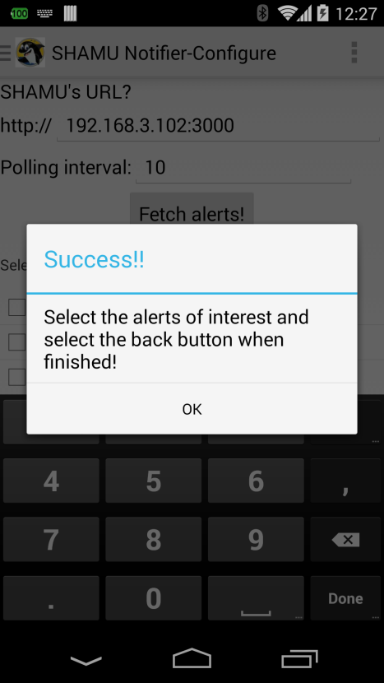
SHAMU Configuration Success
Success! You have reached SHAMU and will be presented with all of the active alerts with the option to select alerts of interest.

Slide 6
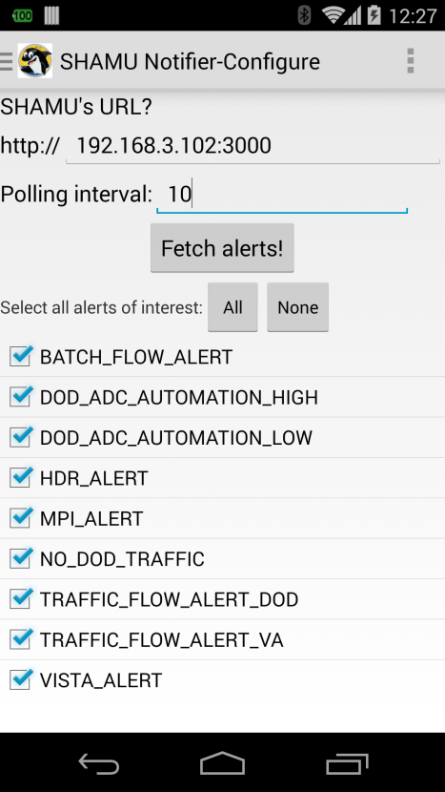
SHAMU – Select Alerts of Interest
Select alerts of interest. You will only be notified for the alerts that you select on this pane.

Slide 7
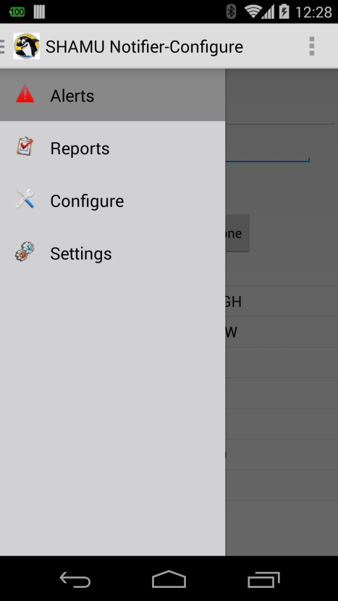
SHAMU – Drawer Menu
Click SHAMU in the title bar to view the menu drawer giving you access to your Alerts, Reports, app Configuration and alert Settings.

Slide 8
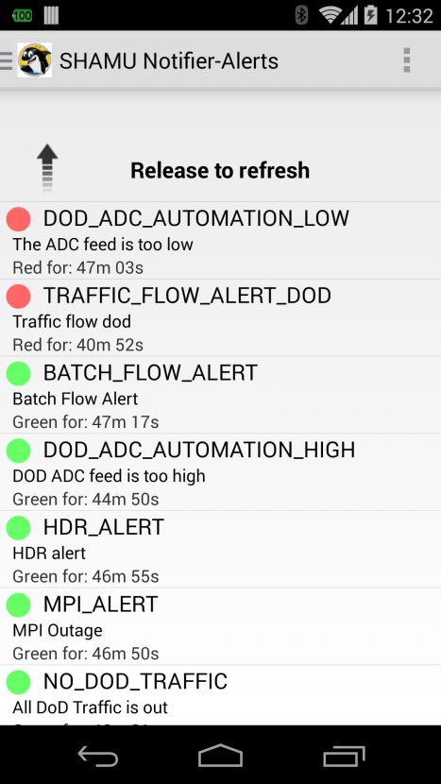
SHAMU – Alert Pull-to-Refresh
When you pull down on the listing a web service call is made to SHAMU and the list is refreshed with the current alert statuses.

Slide 9
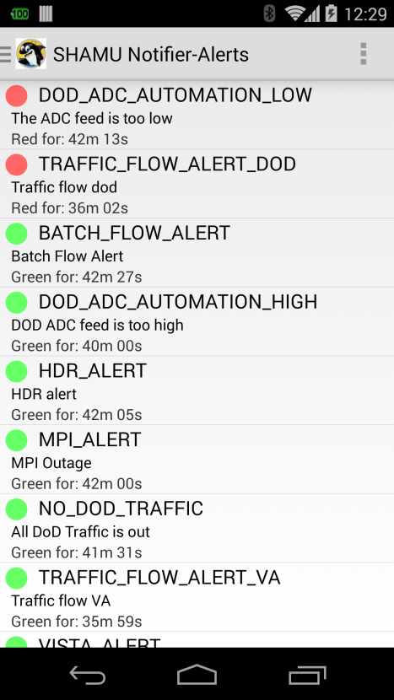
SHAMU – Alert Monitoring Screen
When you click the Alert drawer menu you will see the status of all of the alerts that you are interested in.

Slide 10
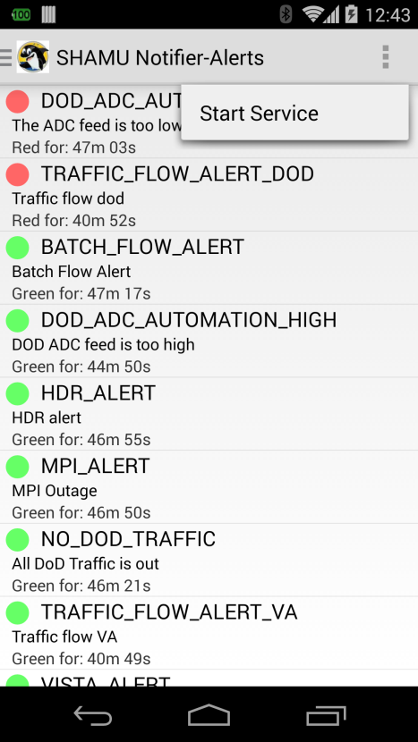
SHAMU – Alert Polling
In the configure pane where you set up the URL for SHAMU you also set up the polling interval in minutes. The ellipses on the top right of the screen drop down a menu to start and stop the service. When started, the alerts are refreshed based on the polling interval and their status is reported to you immediately.

Slide 11

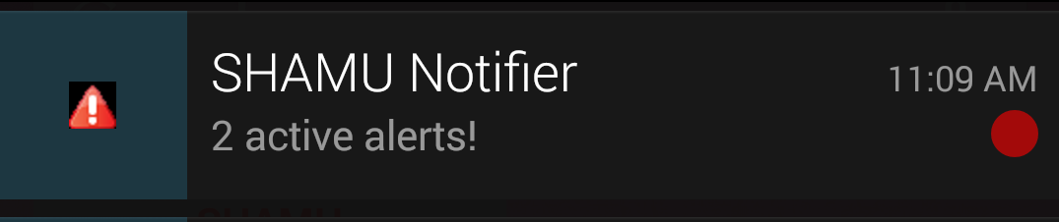
SHAMU – Alert Notification Bar Red Alerts
The alert notification bar indicates when the alert status changes for your alerts of interest and works when you are actively polling SHAMU. The images below are displayed when an alert of interest goes red. As the status of these alerts changes you are notified until all alerts are green (shown on the next slide). Swiping down on the notification bar will display the last image.

Slide 12

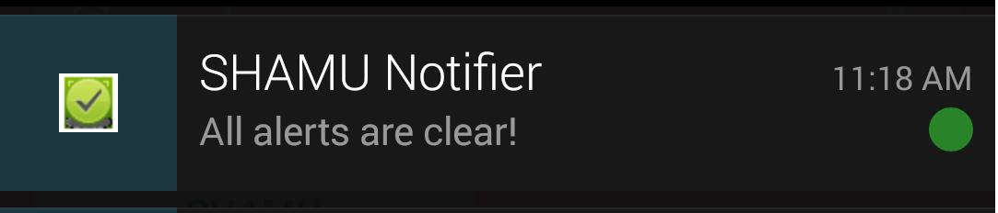
SHAMU – Alert Notification Bar Green Clearing Alerts
The alert notification bar indicates when the alerts clear for your alerts of interest and works when you are actively polling SHAMU. The images below are displayed when all of your alerts of interest clear. Swiping down on the notification bar will display the last image.

Slide 13
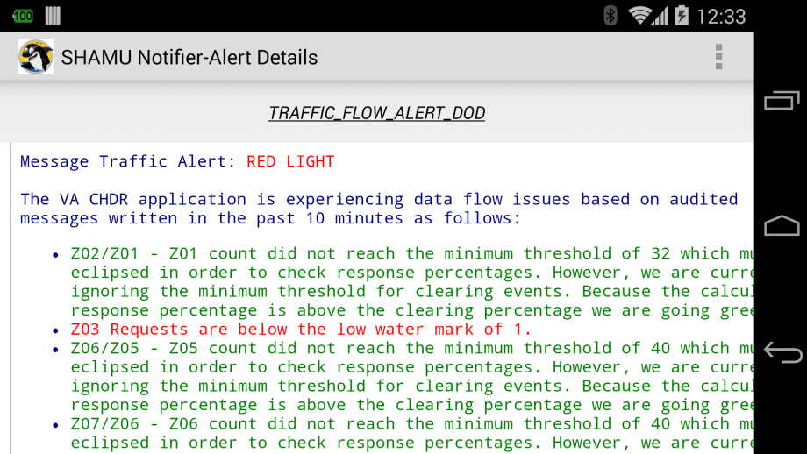
SHAMU – Alert Details
Clicking on a given alert from the alert listing page will open the details pane showing you the job result for that alert.

Slide 14
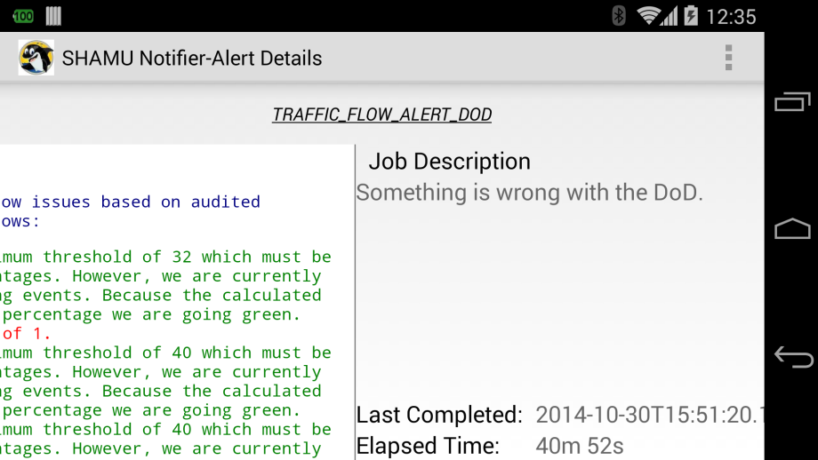
SHAMU – Alert Details (swipe to the left)
When in the alert details pane you can swipe the screen to the left in order to view additional information for a given alert. Swiping back to the right will return you to the main alert detail pane.

Slide 15
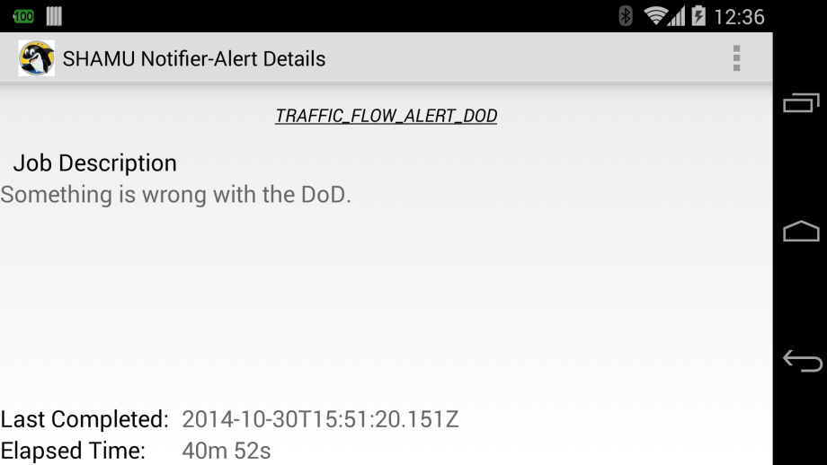
SHAMU – Alert Details (swipe to the left)
The following screen shot is the alert detail pane swiped fully to the left. This displays the additional information about the alert including the job long description, last completed time and the elapsed time for the alert.

Slide 16
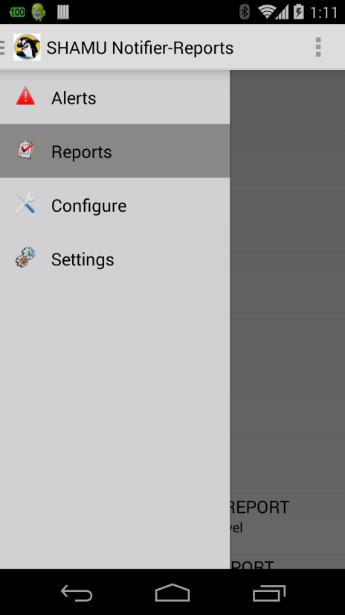
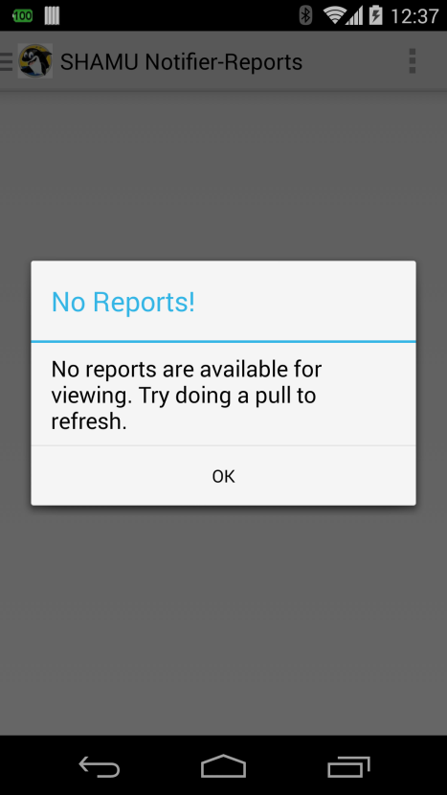
SHAMU – Reports
You access Reports from the drawer menu. Clicking the menu option will present you with a list of active reports. If you receive the message to the right then pull to refresh the reports listing.

Slide 17
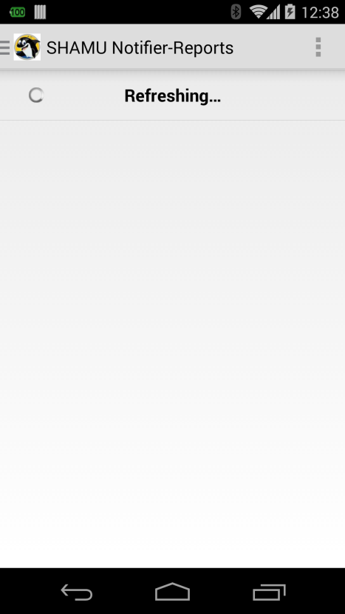
SHAMU – Reports Pull-to-Refresh
To refresh the report listing pane, pull the page down. You will see the pane refreshing and once completed you will see all of the active reports.

Slide 18
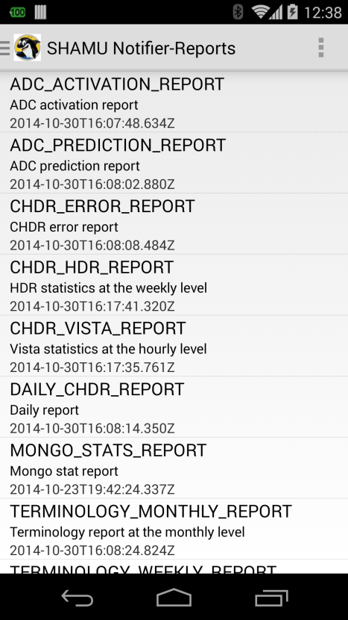
SHAMU – Reports Listing
The report listing pane displays all of the active reports for your viewing pleasure.

Slide 19
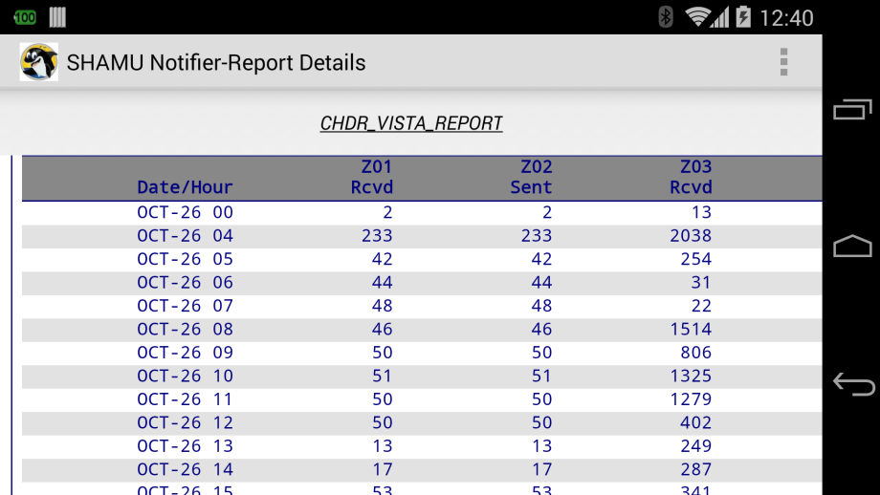
SHAMU – Reports Details
Clicking a given report will display the report details pane.

Slide 20
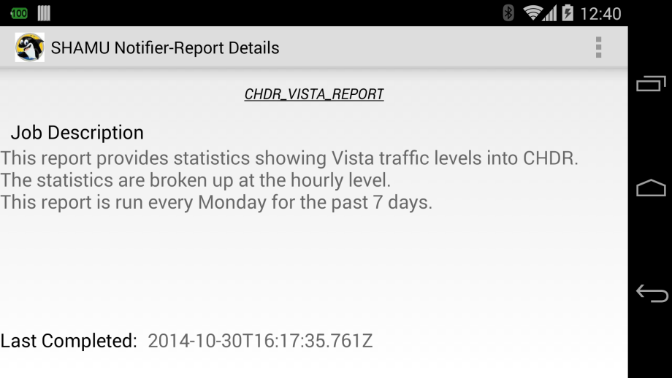
SHAMU – Reports Details (Additional information – swipe left)
From the report details pane, if you swipe the screen to the left you will be presented with additional information about the report including the long job description and the last completed time.

Slide 21
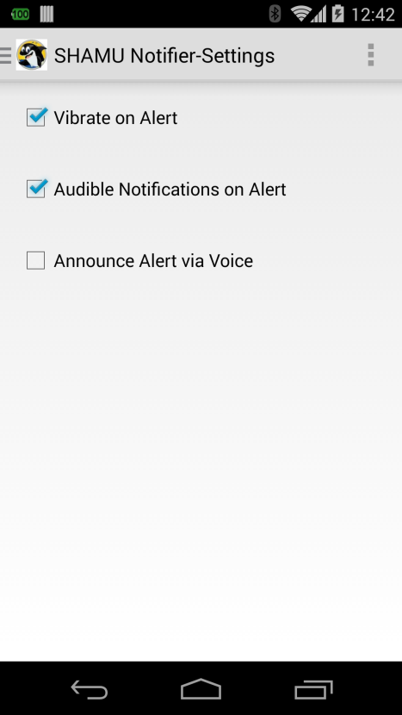
SHAMU – Alert Settings
From the drawer menu the settings menu allows you to configure the actions taken when an alert status changes.

Slide 22
SHAMU – Alert Settings
From the drawer menu the settings menu allows you to configure the actions taken when an alert status changes. These options include:
Vibrate on alert

Slide 23
SHAMU – Alert Settings
From the drawer menu the settings menu allows you to configure the actions taken when an alert status changes. These options include:
Vibrate on alert
Ring on alert

Slide 24
SHAMU – Alert Settings
From the drawer menu the settings menu allows you to configure the actions taken when an alert status changes. These options include:
Vibrate on alert
Ring on alert
And …

Slide 25
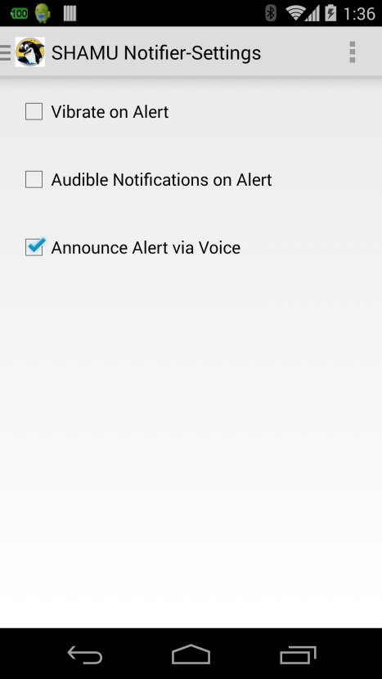
SHAMU – Alert Settings
Enjoy Pandora and get notified of your alerts!

Slide 26
SHAMU – Alert Widget
The SHAMU widget keeps you up to date with SHAMU right from your home page. Just drop the widget onto your home page to see at a glance the state of SHAMU based on your alerts of interest!

Slide 27
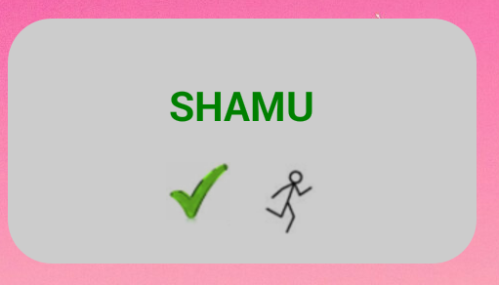
SHAMU – Alert Polling
The widget to the right is displaying that SHAMU is in the green state (all alerts of interest are green) and that we are actively polling as indicated by the running man.

Slide 28
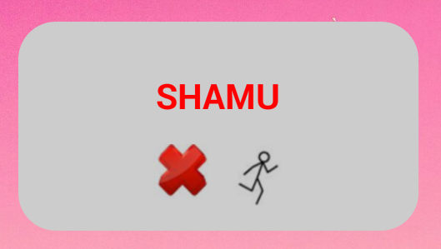
SHAMU – Alert Polling
The widget to the right is displaying that SHAMU is currently alerting as indicated by the red text and red X. The running man, again, indicates that the service is running (a.k.a. we are actively polling).

Slide 29
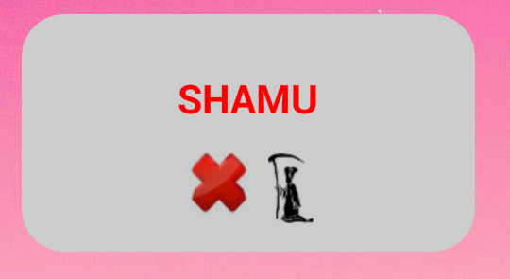
SHAMU – Alert Polling
The widget to the right is displaying that SHAMU was alerting as of the last refresh. The grim reaper indicates that the service is killed (a.k.a. we are not polling) so the red status is as of the last SHAMU refresh.

Slide 30
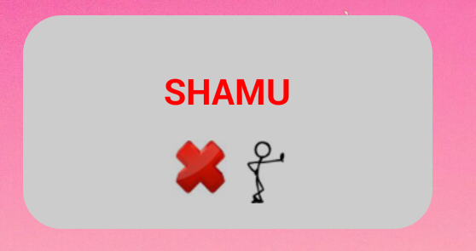
SHAMU – Alert No Network Access
The widget to the right is displaying that SHAMU was alerting as indicated by the red text and red X as of the last refresh. The waiting man indicates that we do not have network access. Once network connectivity returns we will be presented with the running man again.

Slide 31
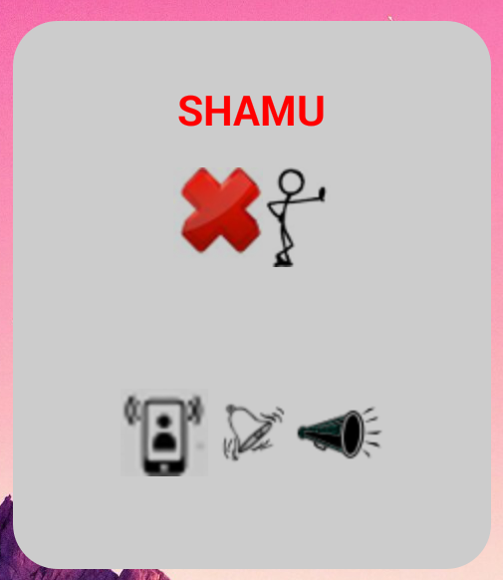
SHAMU – Alert Settings
Resizing the widget by pulling it down will display additional alerting settings. The shaking phone on the far left indicates that the phone will vibrate when an alert is fired. The center image corresponds to the audible setting, and the megaphone to the right indicates that the alert will be announced when the alert fires.

Slide 32


The End…or is it just the beginning?

